Slide 1
CompTIA Security+ Guide to Network Security Fundamentals, Sixth Edition
Chapter 15
Risk Mitigation

Slide 2
Objectives
15.1 Explain how to manage risk
15.2 Describe strategies for reducing risk
15.3 List practices for mitigating risk
15.4 Describe common security issues

Slide 3
Managing Risk
Risk
A situation that involves exposure to some type of danger
Managing risk
To create a level of protection that mitigates the vulnerabilities to the threats and reduces the potential consequences
Involves:
Knowing what threats are being faced
Assessing those risks

Slide 4
Threat Assessment (1 of 3)
Threat assessment
A formal process of examining the seriousness of a potential threat as well as the likelihood that it will be carried out
Three categories of threats:
Environmental
Manmade
Internal vs. external

Slide 5
Threat Assessment (2 of 3)
Threat category | Description | Example
Strategic | Action that affects the long-term goals of the organization | Theft of intellectual property, not pursuing a new opportunity, loss of a major account, competitor entering the market
Compliance | Following (or not following) a regulation or standard | Breach of contract, not responding to the introduction of new laws
Financial | Impact of financial decisions or market factors | Increase in interest rates, global financial crisis
Operational | Events that impact the daily business of the organization | Fire, hazardous chemical spill, power blackout
Technical | Events that affect information technology systems | Denial of service attack, S Q L injection attack, virus
Managerial | Actions related to the management of the organization | Long-term illness of company president, key employee resigning

Slide 6
Threat Assessment (3 of 3)
A threat assessment should be used to determine the asset value
Relative worth of an asset that is at risk
Supply chain assessment
Supply chain – a network that moves a product from the supplier to the customer
Should be viewed as assets to the enterprise and their threats should be cataloged
Assessing threats is not always a straightforward exercise

Slide 7
Risk Assessment
Risk assessment involves:
Testing
Change management
Privilege management
Incident management
Risk calculations
Representing risk information

Slide 8
Testing (1 of 2)
Technology assets should be tested to identify any vulnerabilities
Involves an automated software vulnerability scan through a system
Intrusive vulnerability scan
Attempts to actually penetrate the system to perform a simulated attack
Non-intrusive vulnerability scan
Uses only available information to hypothesize the status of the vulnerability
Penetration test (pentest)
Designed to exploit any weaknesses in systems that are vulnerable
Penetration testing authorization should be obtained

Slide 9
Testing (2 of 2)
Reasons authorization should be obtained:
Legal authorization
Indemnification
Limit retaliation

Slide 10
Change Management (1 of 2)
Change management
Methodology for making modifications and keeping track of changes
Ensures proper documentation of changes so future changes have less chance of creating a vulnerability
Involves all types of changes to information systems
Two major types of changes that need proper documentation
Changes to system architecture
Changes to file or document classification

Slide 11
Change Management (2 of 2)
Change management team (C M T)
Body responsible for overseeing the changes
Composed of representatives from all areas of I T, network security, and upper management
Proposed changes must first be approved by C M T
C M T duties
Review proposed changes
Ensure risk and impact of planned change are understood
Recommend approval, disapproval, deferral, or withdrawal of a requested change
Communicate proposed and approved changes to coworkers

Slide 12
Privilege Management (1 of 2)
Privilege
Subject’s access level over an object, such as a file
Privilege management
Process of assigning and revoking privileges to objects
Privilege auditing
Periodically reviewing a subject’s privileges over an object
Objective: determine if subject has the correct privileges

Slide 13
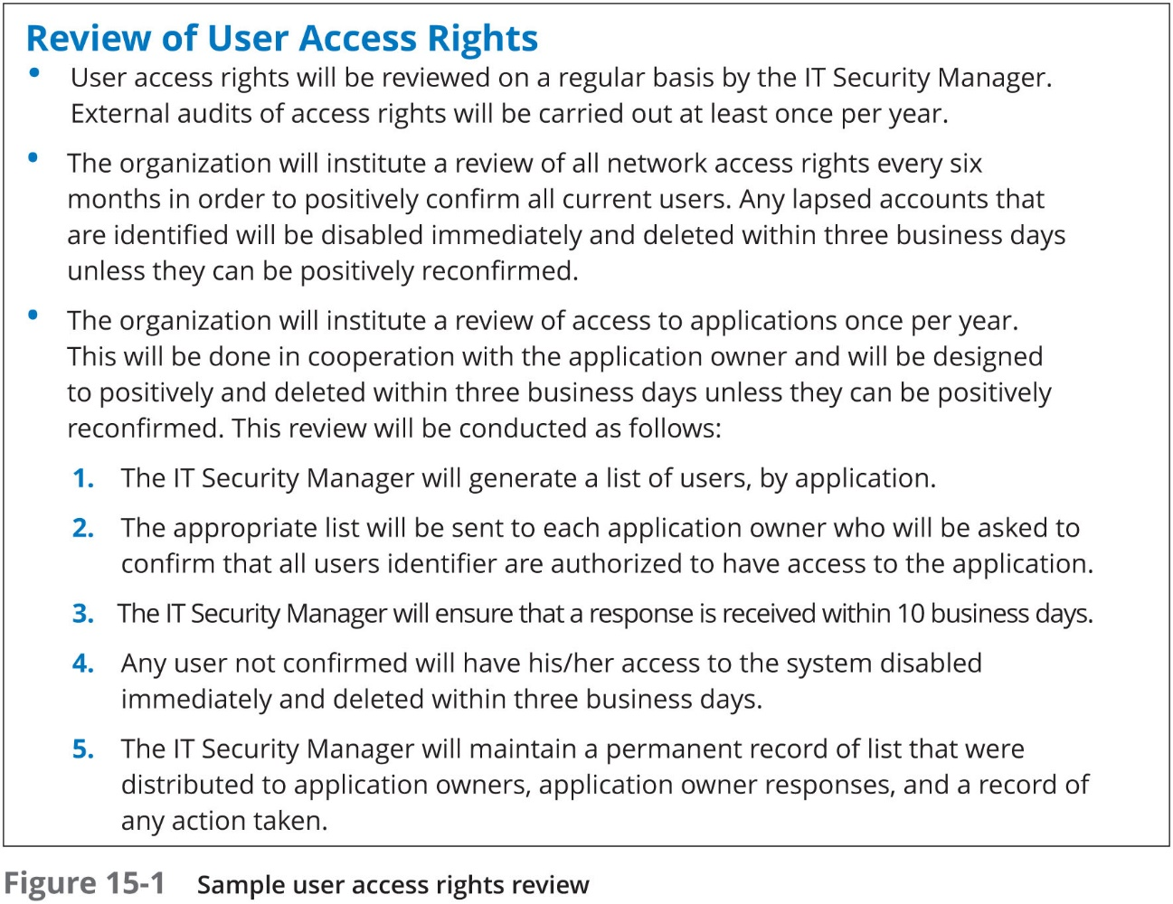
Privilege Management (2 of 2)

Slide 14
Incident Management
Incident response
Components required to identify, analyze, and contain an incident
Incident handling
Planning, coordination, communications, and planning functions needed to resolve incident
Incident management
The “framework” and functions required to enable incident response and incident handling within an organization
Objective: To restore normal operations as quickly as possible with least impact to business or users

Slide 15
Risk Calculation (1 of 6)
Two approaches to risk calculation:
Qualitative risk calculation - uses an “educated guess” based on observation
Typically assigns a numeric value (1-10) or label (High, Medium, or Low) that represents the risk
Quantitative risk calculation - attempts to create “hard” numbers associated with the risk of an element in a system by using historical data
Can be divided into the likelihood of a risk and the impact of a risk being successful

Slide 16
Risk Calculation (2 of 6)
Risk Likelihood
Several quantitative tools can be used to predict the likelihood of the risk
Mean Time Between Failure (M T B F)
Mean Time To Recovery (M T T R)
Mean Time To Failure (M T T F)
Failure In Time (F I T)
Historical data can be used to determine the likelihood of a risk occurring within a year
Known as Annualized Rate of Occurrence (A R O)

Slide 17
Risk Calculation (3 of 6)
Source | Explanation
Police departments | Crime statistics on the area of facilities to determine the probability of vandalism, break-ins, or dangers potentially encountered by personnel
Insurance companies | Risks faced by other companies and the amounts paid out when these risks became reality
Computer incident monitoring organization | Data regarding a variety of technology-related risks, failures, and attacks

Slide 18
Risk Calculation (4 of 6)
Risk Impact
Comparing the monetary loss associated with an asset in order to determine the amount of money that would be list if the risk occurred
Two risk calculation formulas are used to calculate expected losses:
Single Loss Expectancy (S L E) - expected monetary loss every time a risk occurs
Annualized Loss Expectancy (A L E) - expected monetary loss that can be expected for an asset due to risk over a one-year period
Representing Risks
Risk register – a list of potential threats and associated risks
Risk matrix – a visual color-coded tool that lists the impact and likelihood of risks

Slide 19
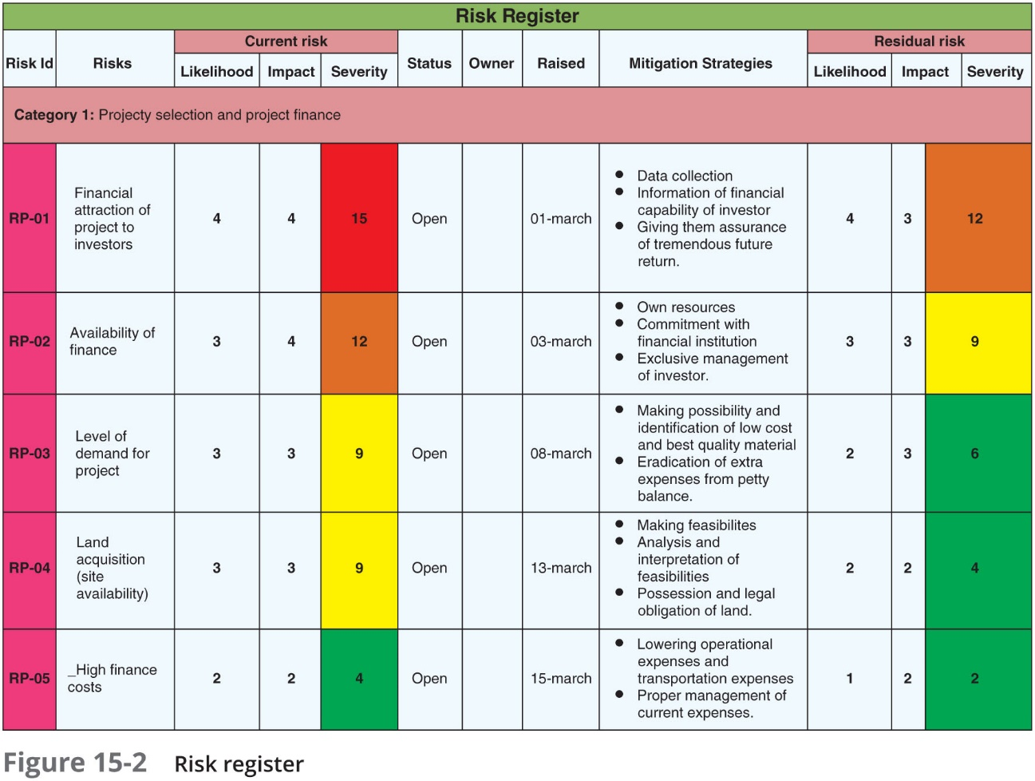
Risk Calculation (5 of 6)

Slide 20
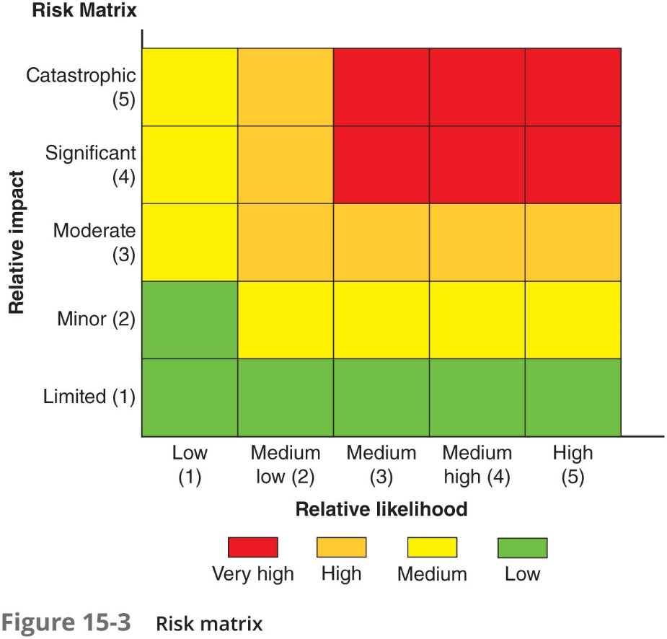
Risk Calculation (6 of 6)

Slide 21
Strategies for Reducing Risk
Approaches for reducing risk:
Using control types
Distributing allocation
Implementing automation

Slide 22
Using Control Types (1 of 2)
Security control
Any device or process that is used to reduce risk
Two levels of security controls:
Administrative controls – processes for developing and ensuring that policies and procedures are carried out
Technical controls – security controls carried out or managed by devices

Slide 23
Using Control Types (2 of 2)
Subtypes of controls that can be either technical or administrative:
Deterrent controls
Preventative controls
Physical controls
Detective controls
Compensating controls
Corrective controls

Slide 24
Distributing Allocation
Distributive allocation refers to “spreading” the risk
Ways to distribute risk include:
Transference - makes a third party responsible for the risk
Risk avoidance - involves identifying the risk and making the decision to not engage in the activity
Mitigation - the attempt to address the risk by making it less serious

Slide 25
Implementing Technology
Risk is often introduced through human error
Using technology as a strategy for reducing risk can minimize these errors
Implementing technology involves using:
Automation
Images and templates
Non-persistence tools

Slide 26
Automation (1 of 2)
Automation
Can be defined as that which replaces human physical activity
Automated courses of action
Using technology to automate I T processes
It automation can provide:
Scalability - the ability to continue to function as the size or volume of the enterprise data center expands to meet the growing demands
Elasticity – the ability to revert to its former size after expanding
Continuous monitoring – sustained and continual surveillance

Slide 27
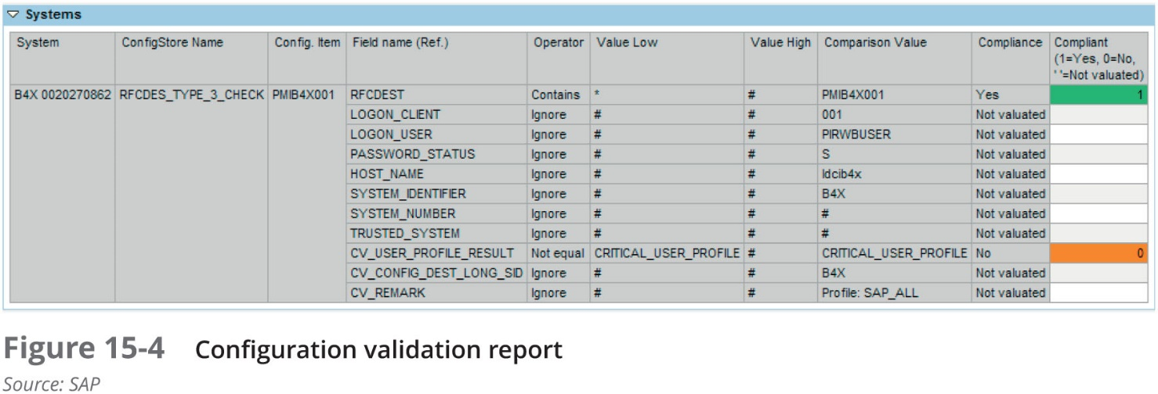
Automation (2 of 2)
Secure configuration guides – available to help I T security personnel configure hardware devices and software to repel attacks
Vendor-specific guides – useful for configuring web servers, O S s, application servers, and network infrastructure devices
Configuration validation
Reviewing the configuration of systems to determine if security settings are correct

Slide 28
Images and Templates
Master image
A copy of a properly configured and secured computer software system that can be replicated to other computers
Eliminates the need for configuring individualized security settings
Template
A type of document in which the standardized content has already been created
The user needs only to enter specialized and variable components
Reduces the amount of data to be entered and helps minimize errors that could introduce a risk

Slide 29
Non-Persistence Tools
Non-persistence tools – used to ensure that unwanted data is not carried forward (clean image is used)
Tool name | Description | How used
Live boot media | A “lightweight” bootable image on a U S B flash drive or optical media | Temporarily creates a secure, non-persistent client for use on a public computer for accessing a secure remote network
Revert to a known state | Restore device to a previous secure condition | Used to reset a device to a stable and secure setting
Rollback to known configuration | Undo recent changes that cause errors or weaken security | Can restore a device to a previous configuration
Snapshot | An instance (image) of a virtual machine | Used to replace a corrupted or infected virtual machine

Slide 30
Practicing for Reducing Risk
Practices for reducing risk:
Security policies
Awareness and training
Agreements
Personnel management

Slide 31
Security Policies
Definition of a Policy
Communicates a consensus of judgment
Defines appropriate behavior for users
Identifies what tools and procedures are needed
Provides directives for Human Resources action in response to inappropriate behavior
May be helpful if it is necessary to prosecute violators

Slide 32
What is a Security Policy? (1 of 3)
Security Policy
A written document that states how an organization plans to protect the company‘s information technology assets
Outlines the protections that should be enacted to ensure the organization’s assets face minimal risk
Having a written security policy empowers an organization to take appropriate action to safeguard its data

Slide 33
What is a Security Policy? (2 of 3)
Security policy functions
An overall intention and direction, formally expressed by the organization’s management
Details specific risks and how to address them
Provides controls to direct employee behavior
Helps create a security-aware organizational culture
Helps ensure employee behavior is directed and monitored in compliance with security requirements

Slide 34
What is a Security Policy? (3 of 3)
An effective security policy must balance: trust and control
Three approaches to trust
Trust everyone all of the time
Trust no one at any time
Trust some people some of the time
Security policy attempts to provide right amount of trust
Trust some people some of the time
Builds trust over time
Level of control must also be balanced
Influenced by security needs and organization’s culture

Slide 35
Types of Security Policies (1 of 4)
A security policy is comprehensive and often detailed
Many organizations break the security policy down into smaller “subpolicies”
Examples:
Acceptable encryption policy
Antivirus policy
Database credentials coding policy
Email policy
Extranet policy
Router security policy
Server security policy
V P N security policy
Wireless communication policy

Slide 36
Types of Security Policies (2 of 4)
Acceptable Use Policy (A U P)
Policy that defines actions users may perform while accessing systems
Users include employees, vendors, contractors, and visitors
Typically covers all computer use, including mobile devices
Unacceptable use may also be outlined by the A U P
Generally considered most important information security policy

Slide 37
Types of Security Policies (3 of 4)
Personal Email Policy
Generally covers three important elements:
Using company email to send personal email messages
Accessing personal email at a place of employment
Forwarding company emails to a personal account
Social Media Policy
Social media network – grouping individuals and organizations into clusters or groups based on some sort of affiliation
Risks of social media:
Personal data can be used maliciously
Users may be too trusting
Accepting friends may have unforeseen consequences
Social media security is lax or confusing

Slide 38
Types of Security Policies (4 of 4)
Social Media Policy (continued)
Social media policy – outlines acceptable employee use of social media be enforced
Reasons for a social media policy:
Setting standards for employee use
Defining limitations
Protecting the enterprise’s reputation
Creating consistency across channels

Slide 39
Awareness and Training (1 of 4)
A key defense in information security:
Providing security awareness and training to users (sometimes called continuing education)
All users need continuous training in the new security defenses and be reminded of company security policies and procedures
Opportunities for security training:
When a new employee is hired
After a computer attack has occurred
When an employee promoted
During an annual department retreat
When new user software is installed
When user hardware is upgraded

Slide 40
Awareness and Training (2 of 4)
Year born | Traits | Number in U.S. population
Prior to 1946 | Patriotic, loyal, faith in institutions | 75 million
1946-1964 | Idealistic, competitive, question authority | 80 million
1965-1981 | Self-reliant, distrustful of institutions, adaptive to technology | 46 million
1982-2000 | Pragmatic, globally concerned, computer literate, media savvy | 76 million

Slide 41
Awareness and Training (3 of 4)
Subject | Pedagogical approach | Andragogical approach
Desire | Motivated by external pressures to get good grades or pass on to the next grade | Motivated by higher self-esteem, more recognition, desire for better quality of life
Student | Dependent on teacher for all learning | Self-directed and responsible for own learning
Subject matter | Defined by what the teacher wants to give | Learning is organized around situations in life or at work
Willingness to learn | Students are informed about what they must learn | A change triggers a readiness to learn or students perceive a gap between where they are and where they want to be

Slide 42
Awareness and Training (4 of 4)
In addition to training styles, there are different learning styles
Visual
Auditory
Kinesthetic
Training styles impact how people learn
Role-based training
Involves specialized training that is customized to the specific role that an employee holds in the organization

Slide 43
Agreements (1 of 2)
Risks of third-party integration:
On-boarding and off-boarding
Application and social media network sharing
Privacy and risk awareness
Data considerations
Interoperability agreements
Formal contractual relationships as they related to security policy and procedures
Part of the standard operating procedures, or those actions and conduct that are considered normal

Slide 44
Agreements (2 of 2)
Agreements that should be regularly reviewed to verify compliance and performance standards include:
Service Level Agreement (S L A) – specifies what services will be provided and the responsibilities of each party
Blanket Purchase Agreement (B P A) – a prearranged purchase or sale agreement between a government agency and a business
Memorandum of Understanding (M O U) – describes an agreement between two or more parties
Interconnection Security Agreement (I S A) – an agreement that is intended to minimize security risks for data transmitted across a network
Non-disclosure agreement (N D A) – a legal contract that specifies how confidential material will be shared between parties but restricted to others

Slide 45
Personnel Management
When hiring, a background check should be conducted
The process of authenticating the information supplied to a potential employer by a job applicant in the applicant’s resume, application, and interviews
When an employee leaves, an exit interview is usually conducted
A “wrap-up” meeting between management representatives and the person leaving an organization either voluntarily or through termination

Slide 46
Troubleshooting Common Security Issues (1 of 2)
Security professionals should have the knowledge and skill to troubleshoot common security issues, including:
Access violations
Asset management
Authentication issues
Baseline deviation
Certificate issues
Data exfiltration
License compliance violation
Logs and events anomalies
Misconfigured devices

Slide 47
Troubleshooting Common Security Issues (2 of 2)
Security professionals should have the knowledge and skill to troubleshoot common security issues, including (continued):
Permission issues
Personnel issues
Unauthorized software
Unencrypted credentials
Weak security configurations

Slide 48
Review Questions
Which of the following risk control types would use video surveillance systems and barricades to limit access to secure sites?
A. operational
B. managerial
C. technical
D. strategic
Which of the following approaches to risk calculation typically assigns a numeric value (1‒10) or label (High, Medium, or Low) represents a risk?
A. Quantitative risk calculation
B. Qualitative risk calculation
C. Rule-based risk calculation
D. Policy-based risk calculation
Which policy defines the actions users may perform while accessing systems and networking equipment?
A. End-user policy
B. Acceptable use policy
C. Internet use policy
D. User permission policy

Slide 49
Chapter Summary (1 of 2)
A risk is a situation that involves exposure to some type of danger
Privilege management and change management are risk management approaches
Two approaches to risk calculation: qualitative risk calculation and quantitative risk calculation
Several approaches are used to reduce risk
A security control and modifying the response to the risk instead of accepting the risk
A policy is a document that outlines specific requirements or rules that must be met

Slide 50
Chapter Summary (2 of 2)
An acceptable use policy (A U P) defines the actions users may perform while accessing systems and networking equipment
Other policies:
Personal email policy
Social media policy
Different parties can reach an understanding of their relationships and responsibilities through interoperability agreements

